Slide 1
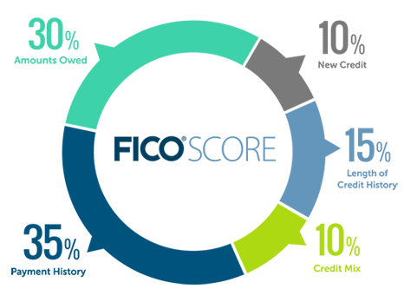
Buying Your First Home
Reality of Realty in Douglas County
Presented by Tenants To Homeowners, & Habitat For Humanity
Made possible by support from

Slide 2
Homeownership: Advantages & Disadvantages
Advantages
disadvantages
Home Equity: forced savings plan
Long term investment that generally appreciates if maintained
Property taxes, interest payments, and some fees can be deducted from taxable income
Due to inflation, mortgage payments actually become cheaper
Easy to step up to a larger home
Have control, can customize home
Monthly mortgage payment may be higher than rent because of taxes and insurance
Regular maintenance and upkeep costs
Up-front costs: closing, down payment
There is no guarantee that property values will increase
It takes time to sell a house and recoup the equity
Much less mobility than renters

Slide 3
Your Expense Plan
Set realistic spending limits
Be willing to live within your plan, it may be necessary to make sacrifices and compromises
Know your priorities
Have consistent spending habits - large expenses can be spread out over time
Track where your money goes
Look for ways to trim, eliminate non-essentials

Slide 4
What lenders want to see for pre-approval
Lenders look at the whole, but they do not like risks
1) Income History
2 years of consistent income. If self-employed, 2 tax years.
Income must be verifiable.
Post-COVID has required more evidence of consistency, if it varies
2) Proof that you pay bills on time
2 years positive bill paying history from credit score 670+
Bankruptcy discharged and all judgements/collections satisfied
3) Low amount of debt
Debt-to-Income Ratio not over 38%
Assets to cover down payment/closing costs

Slide 5
Income: What Can you Afford?
Lender looks at 30-38% of monthly gross minus debt.
70% of payment is principal and interest. The amount you can buy depends on the interest rate.
Must also consider homeowners insurance premiums and property taxes (30% of payment, paid to Escrow).
The amount you have down also influences what you can finance.
Example of 30% Total Monthly Payment with no debt load and a 6.75% Interest Rate:
1. Total Monthly Payment | 2. Principal & Interest | 3. Taxes & Insurance | Amount you can finance
32K annual income
850 | 625 | 225 | 100,000
40K annual income
1,075 | 825 | 250 | 128,000

Slide 6
Looking at Credit
Information found on credit reports: Public records, identification, inquiries, and payment history on revolving debt, installment loans and mortgages.
Standardizes process—goal is to avoid bias.
FICO score 300-850 higher the better. 670+ golden
3 Credit Bureaus—Equifax, Experian, Trans Union—lenders pull composite score or use mean score from all 3.
Some creditors report to only 1, occasionally making scores vary.
Unsettled past dues plunge score.
To dispute an error contact all bureaus in writing online
Use letter of explanation that tells why there are black marks on credit history and why things have changed.
Law requires bureaus to make one free credit report available to you annually—you may request one by phone, mail, or online.
Go to: www.annualcreditreport.com to get your free annual credit report.

Slide 8
High debt vs. low debt
$42,000 annual income
X30%= $1050
-$300 car payment
-$50 student loan
-$100 Target card minimum
-$100 VISA card minimum
$500 available for mortgage
=$55,000 you finance
+ $50,000 subsidy $90,000 total market price
$42,000 annual income
X30%= $1050
No car payment
-$50 student loan
Pays credit cards every month
No credit card balances
$1000 available for mortgage
=$125,000 you finance
+ $50,000 subsidy $175,000 total market price
{
$550 monthly debt load
6.5% interest rate
1.37% real estate tax rate

Slide 9
Fair Housing Act (FHA) Protections
Title VIII of the Civil Rights Act (1968) prohibits discrimination in the rental, sale and financing of most dwellings based on…
Race - Based upon traits, e.g. hair, eye shape, skin, bone structure, etc.
Color - Color of skin
Religion - Religious beliefs or practices
National Origin (Ancestry) - Country where individual or ancestors originated
Sex/Gender - As of February 2021 this officially includes discrimination based on sexual orientation and gender identity
Familial Status - Presence of children under 18 to include pregnant women and families in the process of securing legal custody of a child/children
Disability - Physical or Mental

Slide 10
Housing Discrimination is Illegal! The Fair Housing Act Protects Against:
Steering prospective buyers to other neighborhoods
Refusing to rent, sell, make available, or negotiate
Refusing mortgage loan or insurance
Imposing different terms or conditions for various people
Asking about physical or mental disabilities
Threats, coercion, or intimidation
Advertising preference for certain kinds of tenants or homebuyers

Slide 11
Who Must Comply With Fair Housing Law?
Real estate agents, brokers, lenders, insurance companies, mobile home parks, government housing programs, and multi-family landlords, property managers, maintenance personnel, housing staff, and tenants must comply. Only single-family owners not using an agent are exempt. There are also allowances for senior housing that is based on age.
If you feel like you have been discriminated against, the Fair Housing Law is enforced by the City of Lawrence’s Human Relations Commission, the Department of Housing and Urban Development (HUD) and the Department of Justice (DOJ).
There is a one year filing period.
City of Lawrence Human Relations Division: 785-832-3310 or https://lawrenceks.org/attorney/fairhousing/

Slide 12
Mortgage Types
Conventional Loan
A fixed rate, fixed term loan
Tenants to Homeowners uses conventional loans with income-based down payment.
Adjustable-Rate Mortgage (ARM)
Mortgage made with an interest rate that will change over a period of time.
Rate starts low and then usually goes way up.
FHA Loan
Mortgage insured by the Federal Housing Administration.
Lower down payment (3.5%)
VA Loans
Mortgage guaranteed by the Veteran’s Administration
No down payment.
USDA Loans
Eligible rural homebuyers only
No down payment.
Contract for Deed
Seller Financed.
Bad idea.
Habitat Loan
Habitat for Humanity holds their own loans for program participants.

Slide 13
Predatory Lending
WARNING SIGNS:
Prepayment penalty
Lots of fees
Ballooning
Seems like much more than you can afford
Unnecessary Insurance
Interest only
Not disclosing full payment amount

Slide 14
Shopping for a Home
This is an emotional process that requires patience and compromises.
wants
needs
vs.
There are not a dozen gems in Douglas County under $150,000 to choose from, but a few do come up and you need to be prepared with pre-approval.

Slide 15
Realtors’ Roles
Good realtors provide buyers with access, data, advice and administrative capacity.
Agency roles: Seller’s Agent, Buyer’s Agent, or Transaction Broker
Realtors get paid a % of the listing price (6-7%)
No extra out-of-pocket costs to the buyer to use a buyer’s agent.
Buyer's and seller's agents will split commission
Interview them and dump if they are not listening
Exceptions: For Sale By Owner (FSBO), Habitat for Humanity, Tenants to Homeowners

Slide 16
House Hunting Hints
This is a major purchase! Find out as much as you can:
Get an independent home inspection
Look carefully at seller’s disclosure
Drive by at all hours
Ask neighbors
Look when it rains
Inspector's top 10 list (in handbook)
Get information but also trust your instincts

Slide 17
Home Insurance Basics
Actual cash value vs. full replacement coverage.
Water damage vs. flood damage
Bundling home & car = best discounts
Trampolines, dogs, etc. that make coverage difficult or expensive
Keep deductible at an amount you can get to in an emergency, do not just go for the lowest available. Low deductible = higher rate.
Claims should be used for emergencies. More claims = higher rate.
Before making a claim, talk to your agent, get an estimate, and compare with your deductible.
Shop around, but remember insurance rates are cyclical and hopping may reduce loyalty deductions
Do not use the lender for insurance

Slide 18
Transaction Process
Contract: Legal document guides the transaction. A contract can contain any elements, but typically specify: 1. price 2. closing date 3. inspection and 4. other contingencies
 You and your realtor make a contract offer
The seller’s either: rejects, counters, or accepts
You are now under contract  pay earnest money
Inspections and Negotiations  attend mechanical inspection
Seller provides proof of clear title
Title Company and Lender prepare closing paperwork
 lender requests which insurance company you want to use
By closing date: You must  have down payment  sign loan docs  get utilities and insurance in your name  take possession of your new home!

Slide 19
Pre-Closing
Do…
Do not…
Keep original or online employer/bank access to pay stubs, bank statements, etc.
Provide earnest money from your own bank account or traceable “gift funds”
Tell your loan officer if you plan to receive gift funds at closing
Notify the loan officer of any financial employment changes
Be aware that a new credit report will be pulled just prior to closing
Change jobs or employment without inquiring about the impact it might have on your loan
Increase debt liabilities by opening new loan accounts before closing
This includes making new purchases after preapproval as this could impact final loan approval at close

Slide 20
Home maintenance when not “if”
Water is most damaging
Furnace filter change is important
The ground moves and concrete cracks
Must maintain drainage around house
Climate is hardest on housing
Golden rule of maintenance fund: 1% of house value per year to afford system replacement throughout lifecycle

Slide 21
Lawrence Community Housing Trust
Rebecca Buford, Executive Director
Ashley Taylor, Homebuyer Program Manager
Call us anytime 785-842-5494
www.tenants-to-homeowners.org

Slide 22
What is a Lawrence Community Housing Trust Home?
In exchange for approximately $50,000 to $80,000 off the initial price:
Homebuyer has title to the improvements
LCHT has title to the land, homeowner has right to use the land like any other homeowner
Homebuyer agrees to sell at a restricted resale price to an eligible buyer, maintaining affordability
99-year ground lease is the legal instrument that allows us to maintain affordability
Homebuyer pays nominal ground lease fee of $30/month

Slide 23
How the restricted resale works
We use a resale formula to calculate resale price.
Having ownership of the land is the legal mechanism that allows us to restrict price.
Resale Price = Initial sales price to buyer + 25% of market appreciation
A family that purchases a housing trust home gets two kinds of equity: EQUITY 1 = All of the money they put down and paid on their first mortgage
EQUITY 2 = Plus 25% of market appreciation of their home while they lived there
…they also get to live in a home that is valued at $50K-80K more than they could afford on their own.
This often means an extra bedroom, less maintenance, and energy efficiency (lower utility bills).

Slide 24
Why buy with Tenants to Homeowners?
Living in a house worth 50K more than you pay means an extra bedroom, a garage, or a new house vs. a 60-year-old house.
Our homes are Energy Star rated = ~ $250 monthly savings in utilities
No Private Mortgage Insurance—saves $150/mo.
Save $4500 in closing costs
Affordable down payment based on your income (5% of annual gross)
Lower taxes based on resale formula price
Support from TTH throughout homeownership: tool lending library, maintenance help, support in financial emergencies

Slide 25
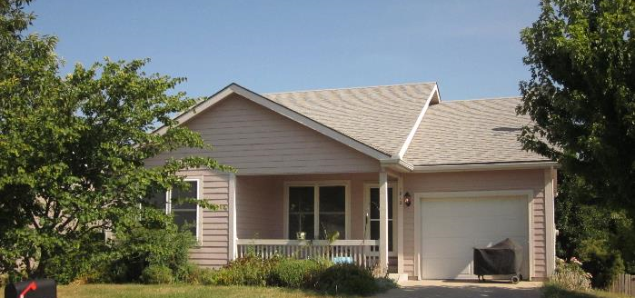
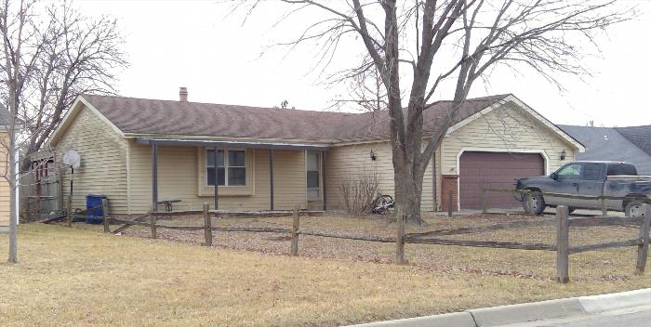
Example Sales
In 2021 our average subsidy per home was $46,000 plus $4,000 in closing costs bringing our average sale price to just $122,100. The Lawrence Board of Realtors average 2021 sales price was $294,591.
TTH Resale: 1812 Atherton court
Market SALE: 2524 Allison drive
$130,300 Sale Date: January 2022
3 bedrooms, 2 bathrooms
Sq Ft: 1,700
Year Built: 2000
Features: 1 car attached garage, walk out basement with finished area
$240,000 Sale Date: October 2021
2 bedrooms, 3 bathrooms
Sq Ft: 1,531
Year Built: 1984
Features: 2 car attached garage, basement with finished area

Slide 26
Income Qualification 2022-23
Add the annual gross (before-taxes) income of all adults in your household.
If that total is less than or equal to the number below your household size, then you are income-eligible
Household Size | 1 | 2 | 3 | 4 | 5 | 6
Max. Annual Gross Income* | $53,000 | $60,600 | $68,150 | $75,700 | $81,800 | $87,850
*Based on HUD HOME Income Guidelines of 80% AMI for Lawrence, KS MSA. Updated annually in June.
**Kansas Housing Resources Corporation (KHRC) Moderate Income Housing (MIH) projects require a minimum income of 60% AMI for Kansas in 2020. Our projects in Baldwin City and Eudora are funded with KHRC MIH funds.

Slide 27
How to buy with Tenants to Homeowners
Attend a homebuyer workshop 
Come in for a pre-qualifying session with TTH
Budget counseling at Housing and Credit Counseling Inc. (HCCI)
Apply through a Housing Trust lender
Get pre-approval from lender
Look for a home available through the program that fits your needs
Get a contract to purchase your new home, go through the purchasing process with support from TTH.
Continued support from Tenants to Homeowners throughout the homeownership journey
Call us at 785-842-5494 or email Ashley @ ataylortth@gmail.com to get started!

Slide 28
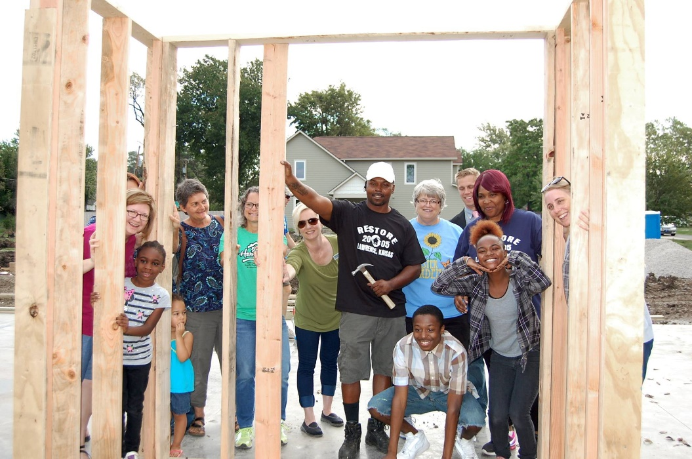
Habitat for Humanity is a nonprofit organization that helps families build and improve places to call home.
We’ve been building community in Douglas County since 1989.
We build strength, stability and
self-reliance through shelter.

Slide 29
Lawrence Habitat Programs
Homeownership Program
Families complete a selection process to build and own a home
Home Repair Program
Critical repairs and Aging in Place
Pathways to Homeownership Program
Prepares families to become homeowners and go through the application process

Slide 30
Homeownership Program
Families who are selected to buy a home must:
Meet eligibility criteria.
Perform sweat-equity hours.
Attend workshops and classes.
Pay $1,200 in closing costs.
Purchase homeowners insurance.
Arrange for all utilities and pay any required deposits.

Slide 31
Selection Criteria
Ability to pay
Legal, stable income
Income falls within income guidelines
Good credit history (640+)
The family’s income is adequate to make the monthly principal, interest, tax, and insurance payments while also meeting their other debt and living expenses.
Need
The family is cost burdened (spending 30% or more on housing)
Current housing is unsafe, and/or overcrowded
Willingness to partner
Sweat equity
Workshop attendance
Live and/or work in Douglas or Jefferson County for one year prior to application
Notes:
See HFHI’s Web site for information on how families are selected (http://www.habitat.org/how/factsheet.html#select).

Slide 32
Income Guidelines
Household Size | 1 | 2 | 3 | 4 | 5 | 6
Max. Annual Gross Income | $47,350 | $54,100 | $60,850 | $67,600 | $73,050 | $78,450
Min. Annual Gross Income | $32,138 | $36,713 | $41,325 | $45,900 | $49,575 | $53,250

Slide 33
House Info
Habitat house prices are based the appraised Fair Market Value
Mortgage payments, including interest, insurance and taxes, will not exceed 30% of the family’s gross monthly income
Newly constructed Habitat homes have approximately 1,500 to 2,000 square feet of living space.
Homes have a reinforced closet for protection in severe weather.
Habitat builds homes with volunteers but with professional quality and care.
Notes:
Add in your local house prices – It may be prudent to use a “Not to Exceed” amount, particularly if the affiliate is not certain about the house price. See information of cost of housing at HFHI’s Web site (http://www.habitat.org/how/factsheet.html#cost).

Slide 34
Pathways to Homeownership
Families who may not be financially ready to own a home are paired with a volunteer coach/mentor
The family participates in the Pathways program to prepare for homeownership
Once graduated from the program, families are encouraged to apply for the Homeownership program through Habitat, Tenants to Homeowners or a variety of other programs
First step is to fill out an application

Slide 35
Next Steps
Pick up an application!
Applications can be picked up at our office or mailed
Office address 720 Connecticut, Lawrence KS
To request a mailed application, email buildinghope@lawrencehabitat.org or visit lawrencehabitat.org and click on Homeownership
Questions?
Erika Zimmerman
director@lawrencehabitat.org
913-369-7037

Slide 36
What’s your next step?
Everyone’s path to homeownership is different. Your next step could be:
Scheduling budget counseling or student loan repayment counseling with HCCI
Making a plan to pay down debt, build credit, or save up for homeownership costs
Picking up an application for a Lawrence Habitat for Humanity Program
Scheduling a Prequalification with Tenants to Homeowners
Slides and handbook is available at: tenants-to-homeowners.org/homebuyer-workshop

